Slide 1

Payment Gateway With Full Source Code
Enterprise Grade Solution
Customizable payment processing platform for business seeking
Branded financial services without infrastructure investment by ITIO Innovex

Slide 2








OUR PAYMENT GATEWAY
Customizable And Future-rich
Integration Superpower
Responsive User Interface
End-to-end Encryption
Connect to acquirers faster
Built for any device
SSL/TLS Security
Real-Time Analytics
Multi-Currency
Pay-in & Pay-out
Monitor Transactions
Global Card Support
Deposits, Refunds, & More
OUR USP: Integration Made Easy
We help you kick start your business

Slide 3



The Business Payment Bottleneck
Current Market Pain Points
Challenges
Our Solutions
Infrastructure Costs
Building payment systems requires massive capital investment in servers, licenses, security protocols and compliance
Development Complexity
Creating secure payment processing demands specialized expertise and years of development time
Regulatory Compliance
Meeting PCI DSS, KYC, AML standards requires dedicated compliance teams and resources
Ready Infrastructure
Complete payment platform with servers, licensing, and security already established and maintained
Instant Deployment
Launch branded payment services within weeks using our proven technology stack
Built-in Compliance
All regulatory standards pre-implemented with ongoing compliance monitoring and updates

Slide 4



Unfair Competitive Advantages
Why Choose ITIO Innovex
Our Strengths
Market Gaps
Complete white-label solution with full customization and branding control for maximum market differentiation
Enterprise-grade security with PCl DSS Level 1 compliance and advanced fraud protection
Rapid deployment within 8 weeks compared to years of in-house development
Comprehensive API suite with extensive documentation and developer support resources
24/7 dedicated support with local expertise and proactive monitoring services
Limited customization options in existing solutions restricting brand control and flexibility
High infrastructure costs and complex compliance requirements for new entrants
Long development cycles delaying time-to-market opportunities and revenue generation
Inadequate integration support causing implementation delays and technical challenges
Poor customer service and limited ongoing support from traditional providers

Slide 5



The Fix: Solution Overview
Inside the ITIO Innovex Platform
CORE PLATFORM
Payment Engine
Robust payment processing infrastructure supporting multiple payment methods, currencies, and real-time transaction processing with 99.9% uptime guarantee
CUSTOMIZATION
Brand Control
Complete white-label solution allowing full customization of user interface, branding elements, domain, and customer experience under your brand
INTEGRATION
Seamless APIs
Comprehensive REST APIs and SDKs enabling quick integration with existing systems, websites, mobile apps, and enterprise software platforms

Slide 6




Power Features That Drive ITIO Innovex
:End-to-End Payment Powerhouse
Multi-Currency Assets( fiat + crypto)
Real-Time Processing
Support for 150+ currencies with real-time exchange rates, automatic currency conversion, and localized payment methods for global market reach
Instant payment processing with immediate settlement capabilities, real-time notifications, and instant transaction status updates for enhanced user experience
Advanced Security
Smart Analytics
Bank-level encryption, fraud detection, tokenization, biometric authentication, and PCI DSS Level 1 compliance ensuring maximum transaction security
Comprehensive dashboard with transaction insights, revenue tracking, customer behavior analysis, and predictive analytics for business intelligence

Slide 7



Smart Dashboard Analytics
Live Business Insights
Transaction Insights
Revenue Analytics
Comprehensive transaction monitoring with real-time data
visualization and detailed reporting capabilities
Comprehensive transaction monitoring with real-time data
visualization and detailed reporting capabilities
99.8%
GROWTH RATE
$2.4M
TOTAL REVENUE
24%
EFFICIENCY
1.2M
IMPROVEMENT

Slide 8















Full-Stack Digital Payments
Launch your own payment gateway with battle-tested code, blazing-fast performance, and bulletproof security — ready to deploy, ready to scale.
F
R
User Onboarding
KYC
Dashboards & Analytics
PAY IN
O
PAY OUT
N
T
E
N
D
Advanced Notifications
Payment Settlement
Payment Orchestration
Support System
Refer & Earn
B
A
C
K
E
N
Multi-Currency
Payment Processing
Compliance with Regulations
Fully Customizable
Integration Ready
D

Slide 9
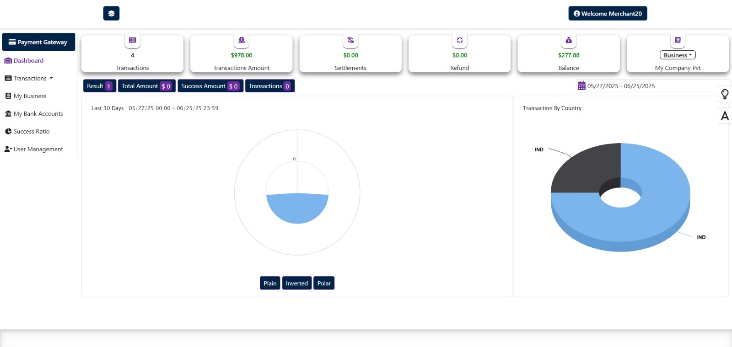
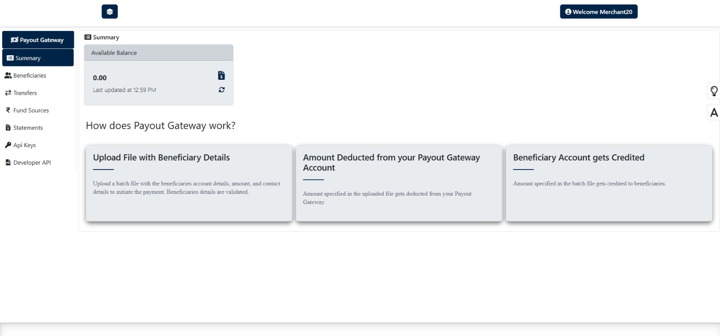
Payment Streams
PAY-IN
PAY-OUT
TRANSACTIONS
MY BUSINESS
USER MANAGEMENT
MY BANK ACCOUNTS
TRANSFERS
FUND SOURCES
API KEYS
STATEMENTS

Slide 10

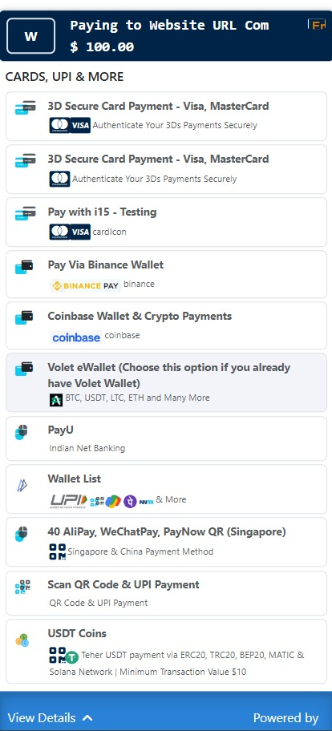
Seamless Payment Choices
VISA, MasterCard
I15 TESTING
BINANCE WALLET
PAY U
UPI
WeChat Pay
USDT Coins
E-Wallet

Slide 11

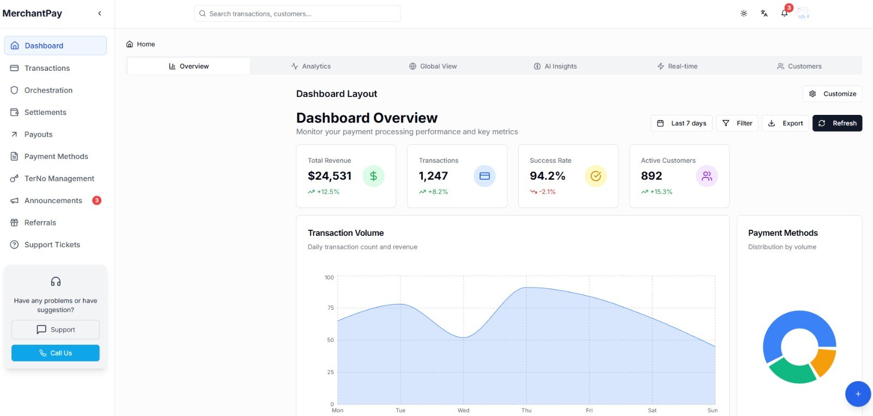




OVERVIEW PANEL
Dashboard Overview
Real-time TPV, success/failure rates
Transaction & settlement tracking
Fraud alerts & risk signals
Payout & refund shortcuts
API/webhook logs & performance

Slide 12
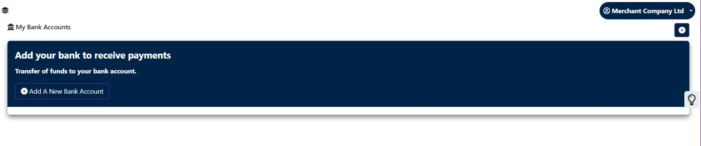
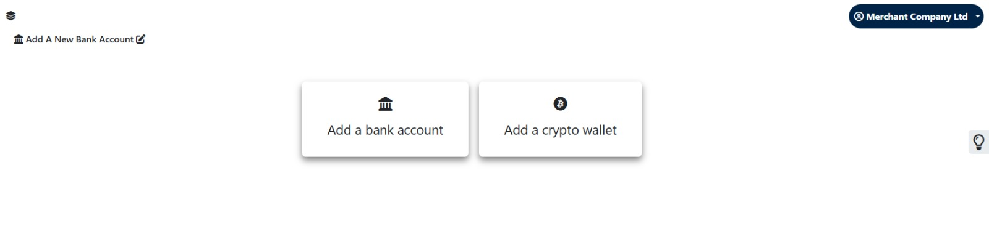
MULTI ASSET SYSTEM
STEP ONE
Open and manage global bank accounts, automate transfers, simplify treasury operations, monitor balances in real time, handle multiple currencies, ensure compliance, and scale financial operations across markets.
STEP TWO

Slide 13
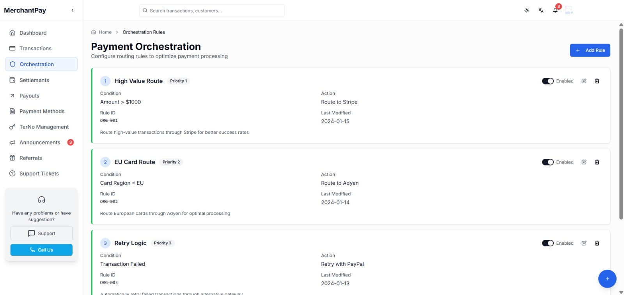
PAYMENT ORCHESTRATION
How It Works
Routes each payment through the most efficient provider.
Instantly retries failed transactions via backups.
Connects multiple PSPs, wallets, and banks seamlessly.
Monitors all payment flows in real-time.
Offers one API to manage all payment methods.
What You Get
Smart routing to maximize success
Automatic failover to backup PSPs
Local vs global gateway switching
Cost-based routing (lowest TDR)
Centralized reporting & insights

Slide 14
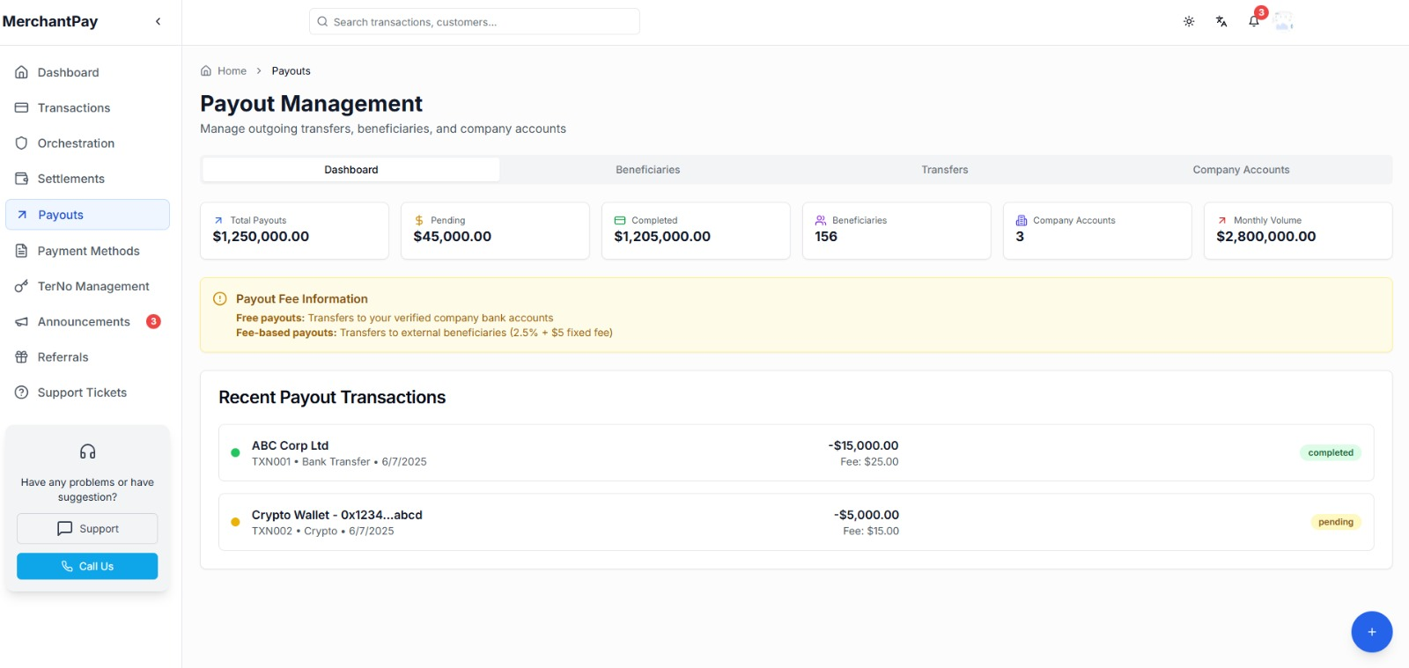
PAYOUT MANAGEMENT
How It Works
Unified layer for all disbursements
Supports API, bulk, and scheduled flows
Works across banks, UPI, wallets, cards
Centralized wallet & ledger control
Seamless partner/vendor/user mapping
What You Get
Instant & bulk payout execution
Bank-wise routing & fallback
Source wallet and balance tracking
Fee caps, limits & audit logs
Real-time payout status & alerts

Slide 15
Supported Methods
Covering every method, every market, every moment.
Support for major International payment
methods ensuring global reach and customer
convenience
Localized payment options for specific
regions enhancing customer experience and
conversion rates

Slide 16

Customization & Branding options
Complete Brand Control
Transform our platform into your branded payment solution with comprehensive customization options including logos,
colors, domains, and user interface elements while maintaining complete control over customer experience and brand
identity,

Slide 17
Unified API Access
Built for speed, simplicity, and scale.
Development Insights
Our comprehensive API suite enables rapid integration with existing systems, reducing development time and ensuring seamless connectivity

Slide 18



Platform Architecture
Enterprise-Grade Infrastructure
Cloud Infrastructure
Security Framework
Tech stack
AWS/Azure multi-region deployment with auto-scaling, load balancing, disaster recovery, and 99.99% uptime SLA
Military-grade encryption, multi-factor authentication, real-time fraud detection, and
continuous security monitoring systems
API-first architecture with PHP Laravel, PostgreSQL-backed modular microservices, and scalable cloud-native deployment for unified orchestration across financial services.
99.99%
UPTIME SLA
PHP Laravel + PostgreSQL
256AES-bit
ENCRYPTION

Slide 19




Built For Compliance
Enterprise security & regulatory
Standard | Level | Status | Coverage | Validation
PCI DSS | Level 1 | CERTIFIED | Payment Data | Annual
ISO 27001 | Full | COMPLIANT | Security Mgmt | Ongoing
GDPR | Complete | CERTIFIED | Data Privacy | Continuous
SOC 2 | Type II | AUDITED | Operations | Quarterly
DATA SOURCE & NOTES
All certifications maintained and updated continuously with dedicated compliance team monitoring regulatory changes

Slide 20





Deployment Plan
Fast Track To Market
WEEK 1-2
Initial Setup
Account Creation,
Requirement analysis,
Technical consultation
And platform
Configuration setup
WEEK 3-4
Integration Phase
API integration, custom
Branding implementation,
Security configuration
And testing protocols
WEEK 5-6
Testing & QA
Comprehensive testing
Security audits,
Performance optimization
And user acceptance
testing
WEEK 7-8
Deployment
Production deployment,
Staff training,
Documentation delivery
And go-live support
WEEK 9+
Support
Ongoing monitoring,
Maintenance, updates
And dedicated customer
Success management

Slide 21
Target Markets
Strategic B2B Opportunities
Primary Markets
Secondary Markets
Core Target Segments
Growth Opportunities
Financial Service
Banks, credit unions, fintech startups seeking branded payment solutions without infrastructure investment and regulatory compliance burden
Enterprise Software
ERP providers, CRM platforms, and business software companies
Adding payment functionality to their existing solutions
E-commerce Platforms
Marketplace operators, SaaS providers, and online retailers requiring integrated payment processing with custom branding capabilities
Payment Resellers
ISOs, MSP, and payment aggregators seeking to expand service offerings with comprehensive white-label payment solutions

Slide 22
Success Metrics
Proven Performance Results
Consistent client acquisition demonstrates market demand and solution effectiveness across diverse industry segments
Growing transaction volumes indicate successful platform adaptation and increasing customer engagement levels

Slide 23
Market Opportunity
Global Payment Gateway Growth
Market size | Growth Rate | Key Drivers | Regional Focus | Forecast
Global Market 2025 | 28.5% | Digital Transformation | Asia-Pacific | $2.29 Billion
Projected 2027 | 230% | E-commerce Expansion | B2B Segment | $6.87 Billion
Industry Analysis
The global white-label payment gateway market is experiencing unprecedented growth, driven by digital transformation and e-commerce expansion across industries.
Market projected to reach $6.87 billion by 2023 with 14.5% CAGR, representing massive opportunity for business
B2B segment leads with 69% market shares, indicating strong demand for enterprise solutions and customizable platforms.

Slide 24
Partnership Opportunities
Strategic Collaboration Models
1
2
3
TECHNOLOGY PARTNERS
CHANNEL PARTNERS
INDUSTRY PARTNERS
Transaction Insights
Reseller Network
Vertical Solutions
Collaborate with software vendors,
system integrators, and technology
providers to create comprehensive
solutions and expand market reach
through strategic partnerships
Build profitable reseller relationships
with payment consultants, ISOs, and
business advisors to accelerate market
penetration and customer acquisition
Develop industry-specific payment
solutions with domain experts in
healthcare, education, retail, and other
vertical markets for specialized
offerings

Slide 25
THANK YOU

